Slide 1
IEEE Project Competition
Week 7: Git/Github Workshop

Slide 2

Attendance

Slide 3
Overview
November 30th, BOM’s are due.
Keep researching topics, and find components that might be useful.
Next slide will show reference and a template BOM, feel free to edit.
Eriks Sumobot Example Project - > Git theory - > Commands - > Git/Github Installation - > Practice

Slide 4
Dos and Don’ts of BOM
DONT
Neglect Power and Size Requirements
Fail to Check for Alternatives
Buy Overkill Components
a
Select Based on Price Alone
Overlook Small yet Still Important Components
DO
Prioritize Compatibility
Research multiple viable options
Choose Parts Based on What is actually Required
Review Parts to Ensure Reliability
Remember to Include Components Like Wires, Please

Slide 5
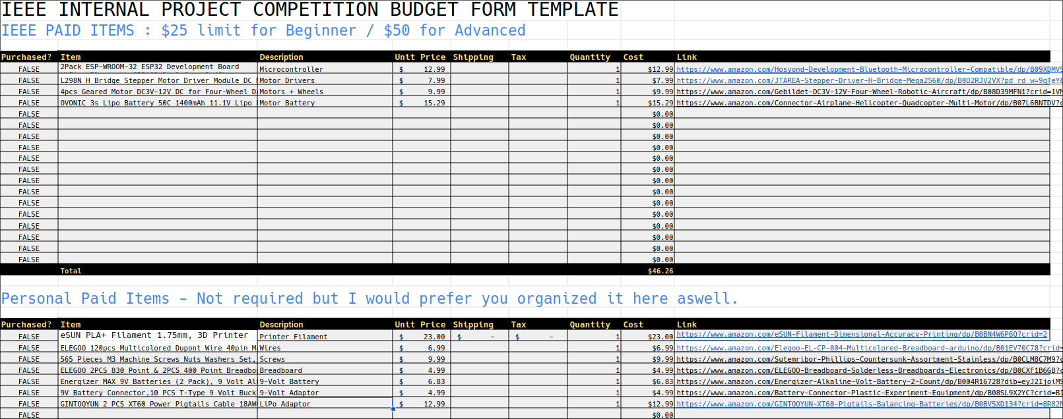
Example BOM
https://docs.google.com/spreadsheets/d/1MzQs9egSNgwi3-KXXFkbnIGUh0TODJRdJ_6OjmiipWM/edit?usp=sharing

Slide 6
Itinerary
What is Version Control?
What is Git?
What is Github?
Practice!

Slide 7
What is Version Control?

Slide 8
Workflow!
Branching!
DevOps!
Documentation!
Traceability!

Slide 9
Definitions and more concrete benefits:
Version Control
the practice of tracking and managing changes to software code. Version control systems are software tools that help software teams manage changes to source code over time.
Workflow
the sequence of industrial, administrative, or other processes through which a piece of work passes from initiation to completion.
Branching
The ability to work on the same source in a separate ‘branch’ allows for many other benefits
Traceability/Documentation
Version Control gives the ability to trace changes all the way to there roots through natural documentation and version tracking

Slide 10
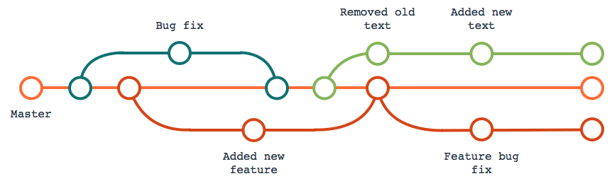
Branching

Slide 11
What is Git?

Slide 12

Background of Git
Created by Linus Torvalds, creator of Linux, in 2005
Came out of Linux development community
Designed to do version control on Linux kernel
Goals of Git:
Speed
Support for non-linear development (thousands of parallel branches)
Fully distributed
Able to handle large projects efficiently
(A "git" is a cranky old man. Linus meant himself.)

Slide 13
Installing/Learning Git
Git website: http://git-scm.com/
Free online book: http://git-scm.com/book
Reference page for Git: http://gitref.org/index.html
Git tutorial: http://schacon.github.com/git/gittutorial.html
My preferred Git tutorial: https://www.atlassian.com/git
At command line (where verb = config, add, commit, etc.):
git help verb

Slide 14
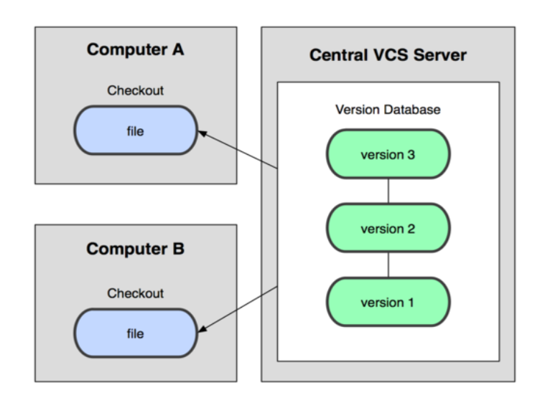
Centralized VCS
In Subversion, CVS, Perforce, etc. A central server repository (repo) holds the "official copy" of the code
the server maintains the sole version history of the repo
You make "checkouts" of it to your local copy
You make local modifications
Your changes are not versioned
When you're done, you "check in" back to the server
Your checkin increments the repo's version

Slide 15
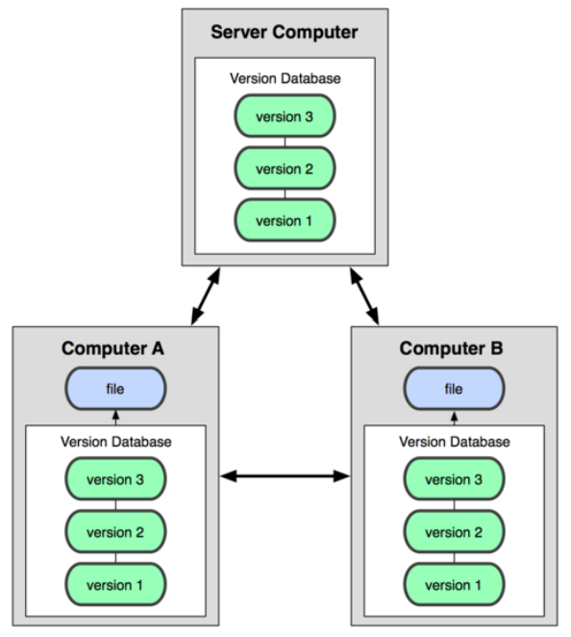
DVCS (Git)
In git, mercurial, etc., you don't "checkout" from a central repo
You "clone" it and "pull" changes from it
Your local repo is a complete copy of everything on the remote server
Yours is "just as good" as theirs
Many operations are local:
check in/out from local repo
commit changes to local repo
local repo keeps version history
When you're ready, you can "push" changes back to server

Slide 16
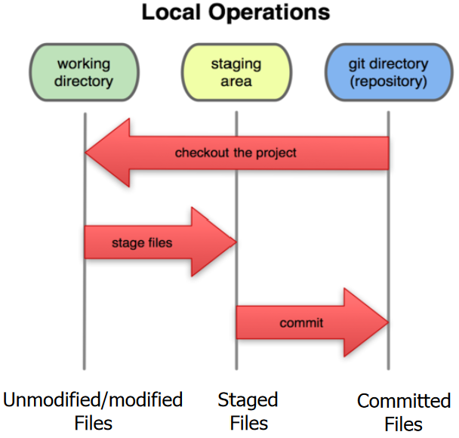
Local Git Areas
In your local copy on git, files can be:
In your local repo
(committed)
Checked out and modified but not yet committed
(working copy)
Or, in-between, in a "staging" area
Staged files are ready to be committed.
A commit saves a snapshot of all staged state.

Slide 17
Creating a Git Repo
Two common scenarios: (only do one of these)
To create a new local Git repo in your current directory:
git init
This will create a .git directory in your current directory
Then you can commit files in that directory into the repo.
git add filename
git commit –m "commit message"
To clone a remote repo to your current directory:
git clone url localDirectoryName
This will create the given local directory, containing a working copy of the files from the repo, and a .git directory (used to hold the staging area and your actual local repo

Slide 18
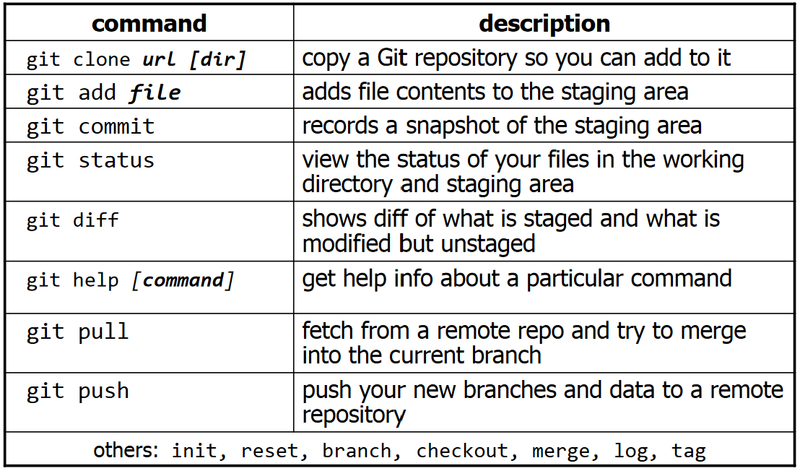
Git Commands

Slide 19
Branching and Merging
Git uses branching heavily to switch between multiple tasks.
To create a new local branch:
git branch name
To list all local branches: (* = current branch)
git branch
To switch to a given local branch:
git checkout branchname
To merge changes from a branch into the local master:
git checkout master
git merge branchname

Slide 20
Interaction w/ remote repo
Push your local changes to the remote repo.
Pull from remote repo to get most recent changes.
(fix conflicts if necessary, add/commit them to your local repo)
To fetch the most recent updates from the remote repo into your local repo, and put them into your working directory:
git pull origin master
To put your changes from your local repo in the remote repo:
git push origin master

Slide 21
Practice
Create a new subdirectory
Create a new git repository in that location
Create new file in that repo
Add it
Commit it!

Slide 22
What is GitHub?

Slide 23
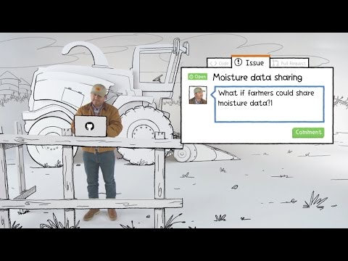

Slide 24


Using Git and GitHub Together
A GitHub Repository is a remote repository that multiple developers can contribute to (push to) and download and edit source code from (pull from).
Pull Requests
Allows other team members to review changes before being merged to main branch
Easy Collaboration with other developers
Task boards (Issues)
Online access to code
Contribution tracking
https://github.com/ucfai/knightros-gambit

Slide 25

Other uses for GitHub
Easy way to document and display a project online
Can be used as a social media (sorta)
https://github.com/nashirj
Easy ePortfolio!
Tons of public repos from random people, github hosts some huge projects!
https://github.com/replicate/scribble-diffusion
https://github.com/ytdl-org/youtube-dl
https://github.com/topydo/topydo

Slide 26

If you are curious…
Tortoisegit
Atlassian Git Tutorial
GitLab
VSCode Git Extensions
Git History
Git Graph
GitLens (I use)

Slide 27
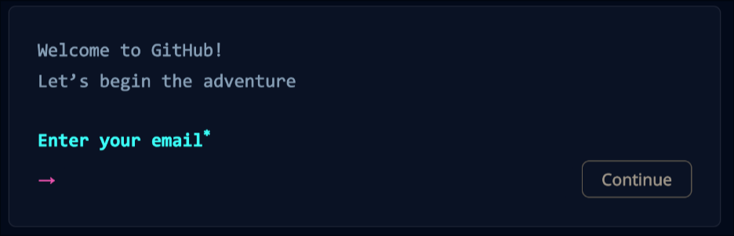
But how to GitHub?
Go to https://github.com
Do what it says

Slide 28
How to download Git?
Windows:
Open Command Prompt
Type the following: “winget install Git.Git”
Choose ‘Y’ when it asks, and let it do it’s thing.
Mac/Linux:
You are cool so you don’t have to install it (It’s already installed)

Slide 29






GitHub Tutorial
https://docs.github.com/en/get-started/quickstart/hello-world

Slide 30
Workshop Time!

